Slide 1
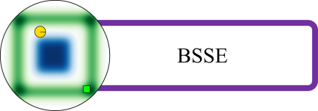
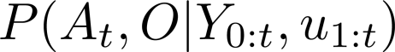
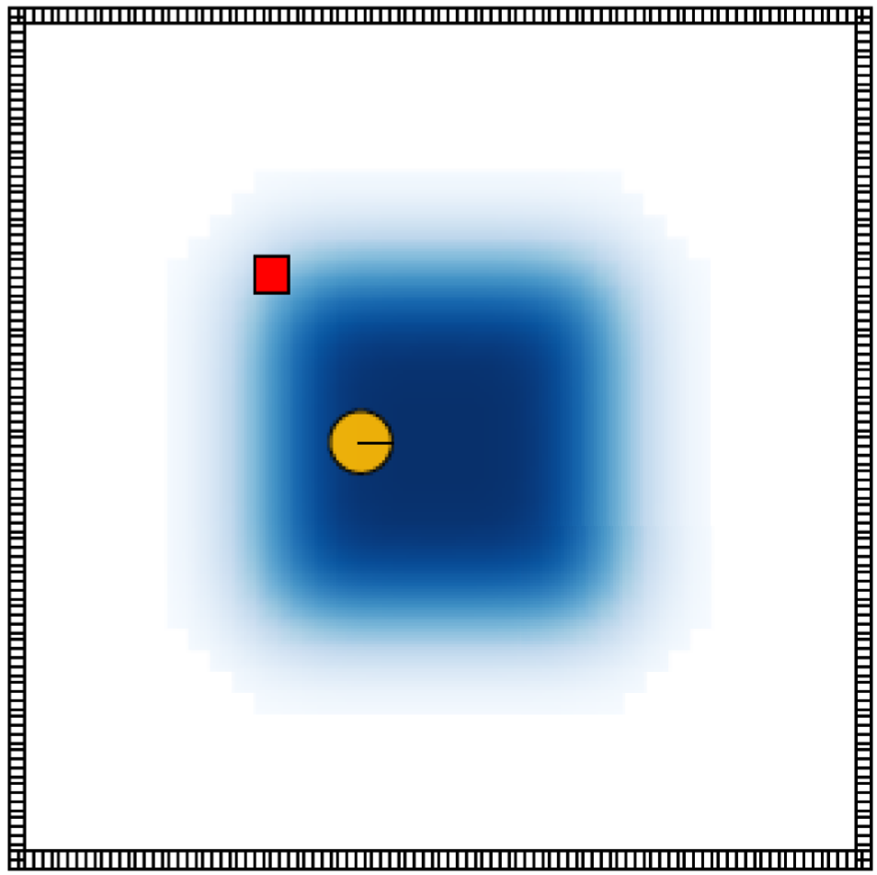
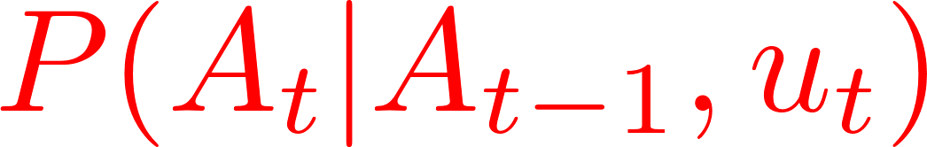
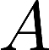
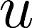
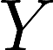
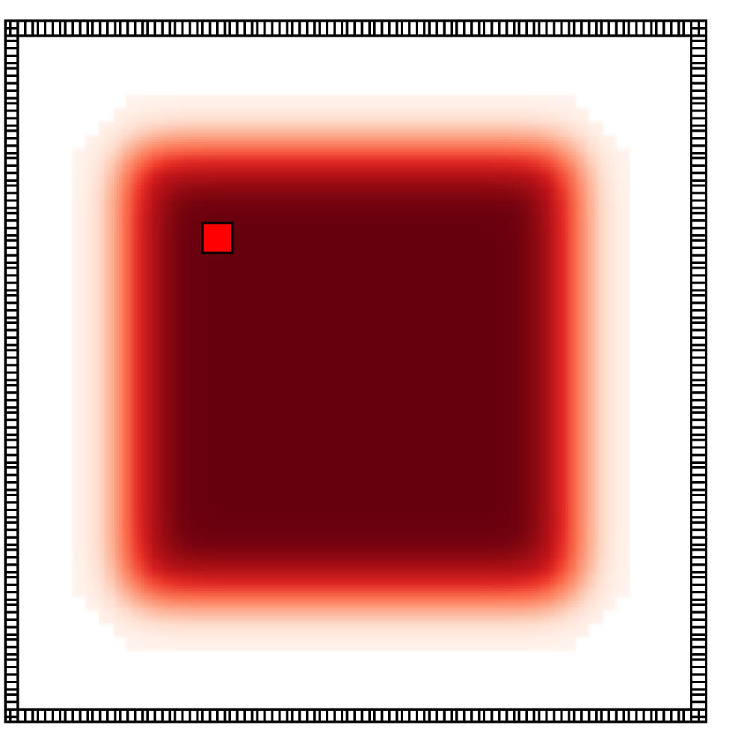
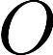
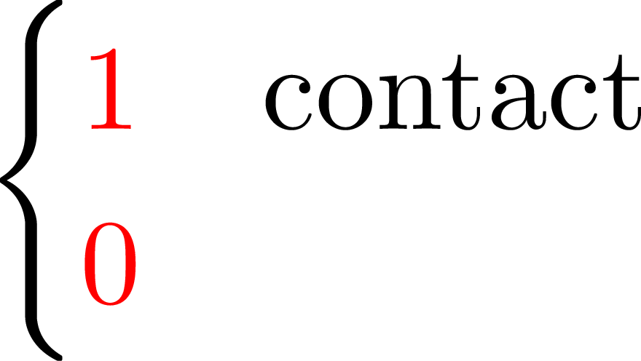
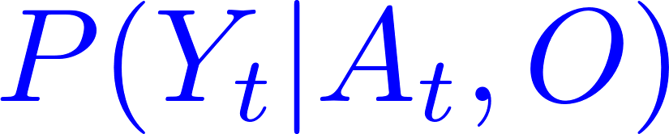
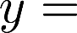
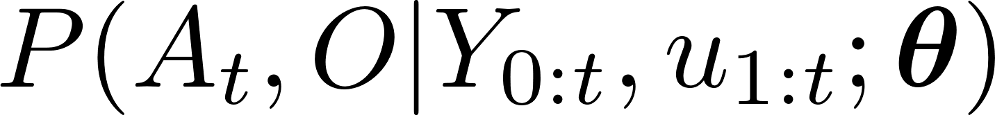
Bayesian State Space Estimation (BSSE)
1
SLAM
Joint
What parameterisation ?
Notes:
By localisation problem we imply that the agent knows the location of the object in the world, however he does not know his own position. We make a generalisation to multiple sources of uncertainty, for instance now the agent no longer knows the position of the red object.
As a result we will have to maintain a recursive estimation of the joint distribution of the agent and objects believed spatial
location conditioned on all measurements up to the current time step. A slight change of notation, the capital later A stands for the random variable associated with the agents position as does the O which stands for the objects position.
This problem is known as SLAM. In which both a motion and measurement models are required.
As we are considering only haptic information and uninformative priors we cannot make any structural assumptions regarding the joint distribution. As a result EKF-SLAM is not suitable and an approach would be to resort to a histogram parameterisation of the joint distribution which is the least constraining.

Slide 2
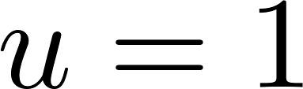
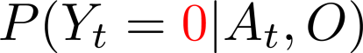
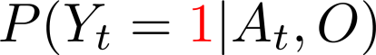
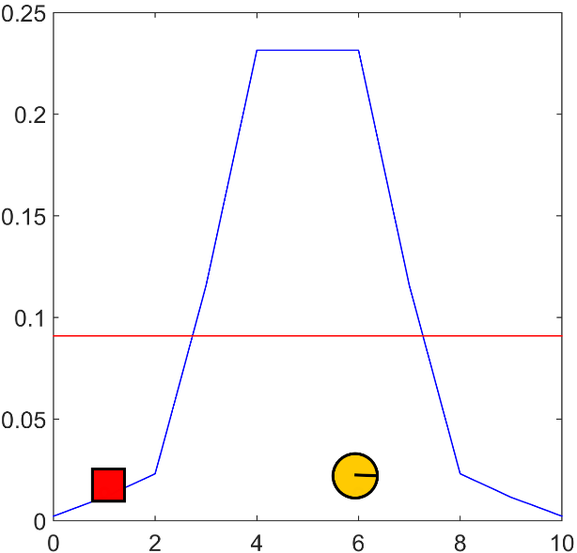
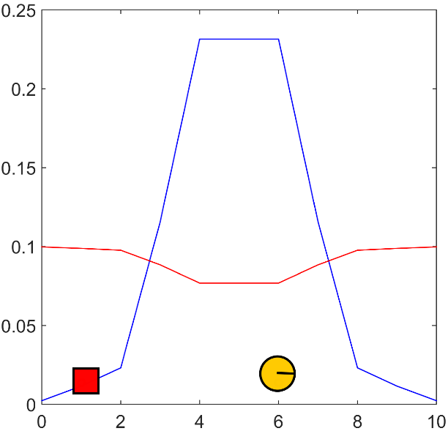
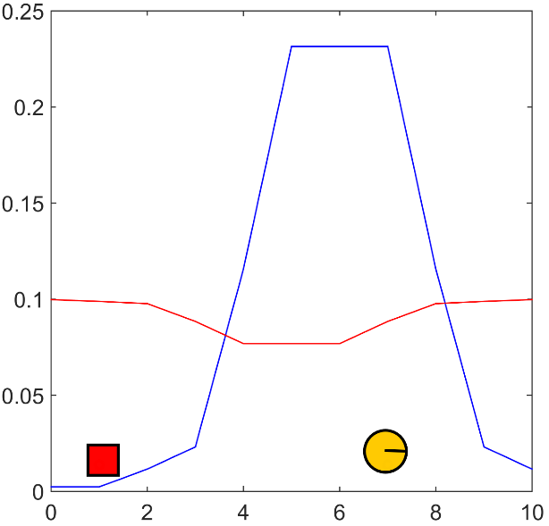
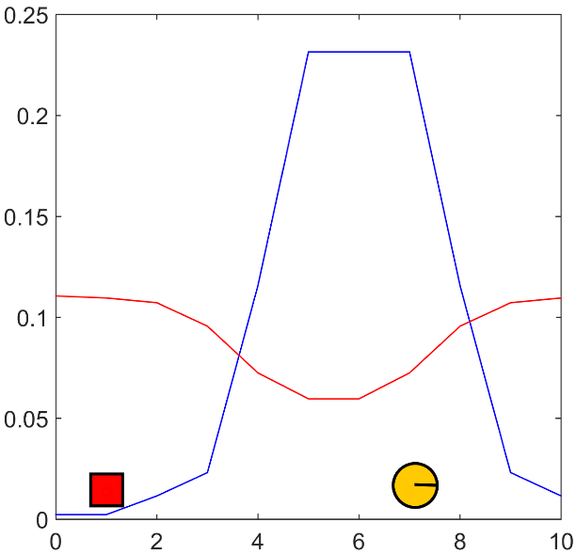

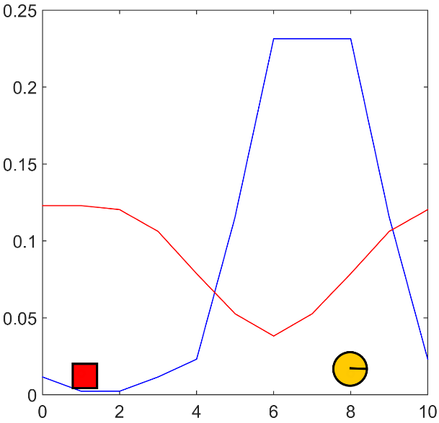
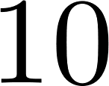
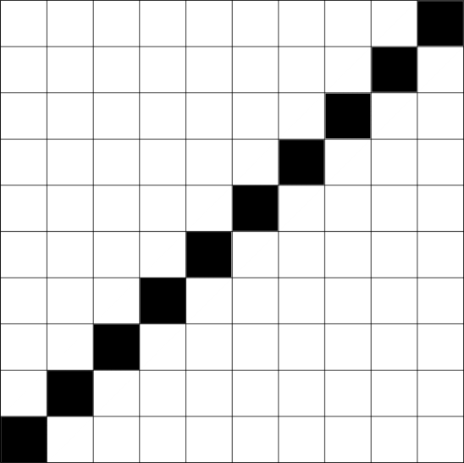
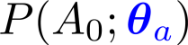
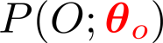
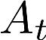

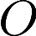
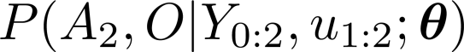
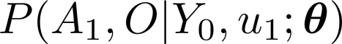
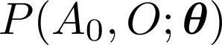
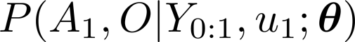
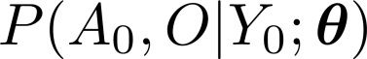
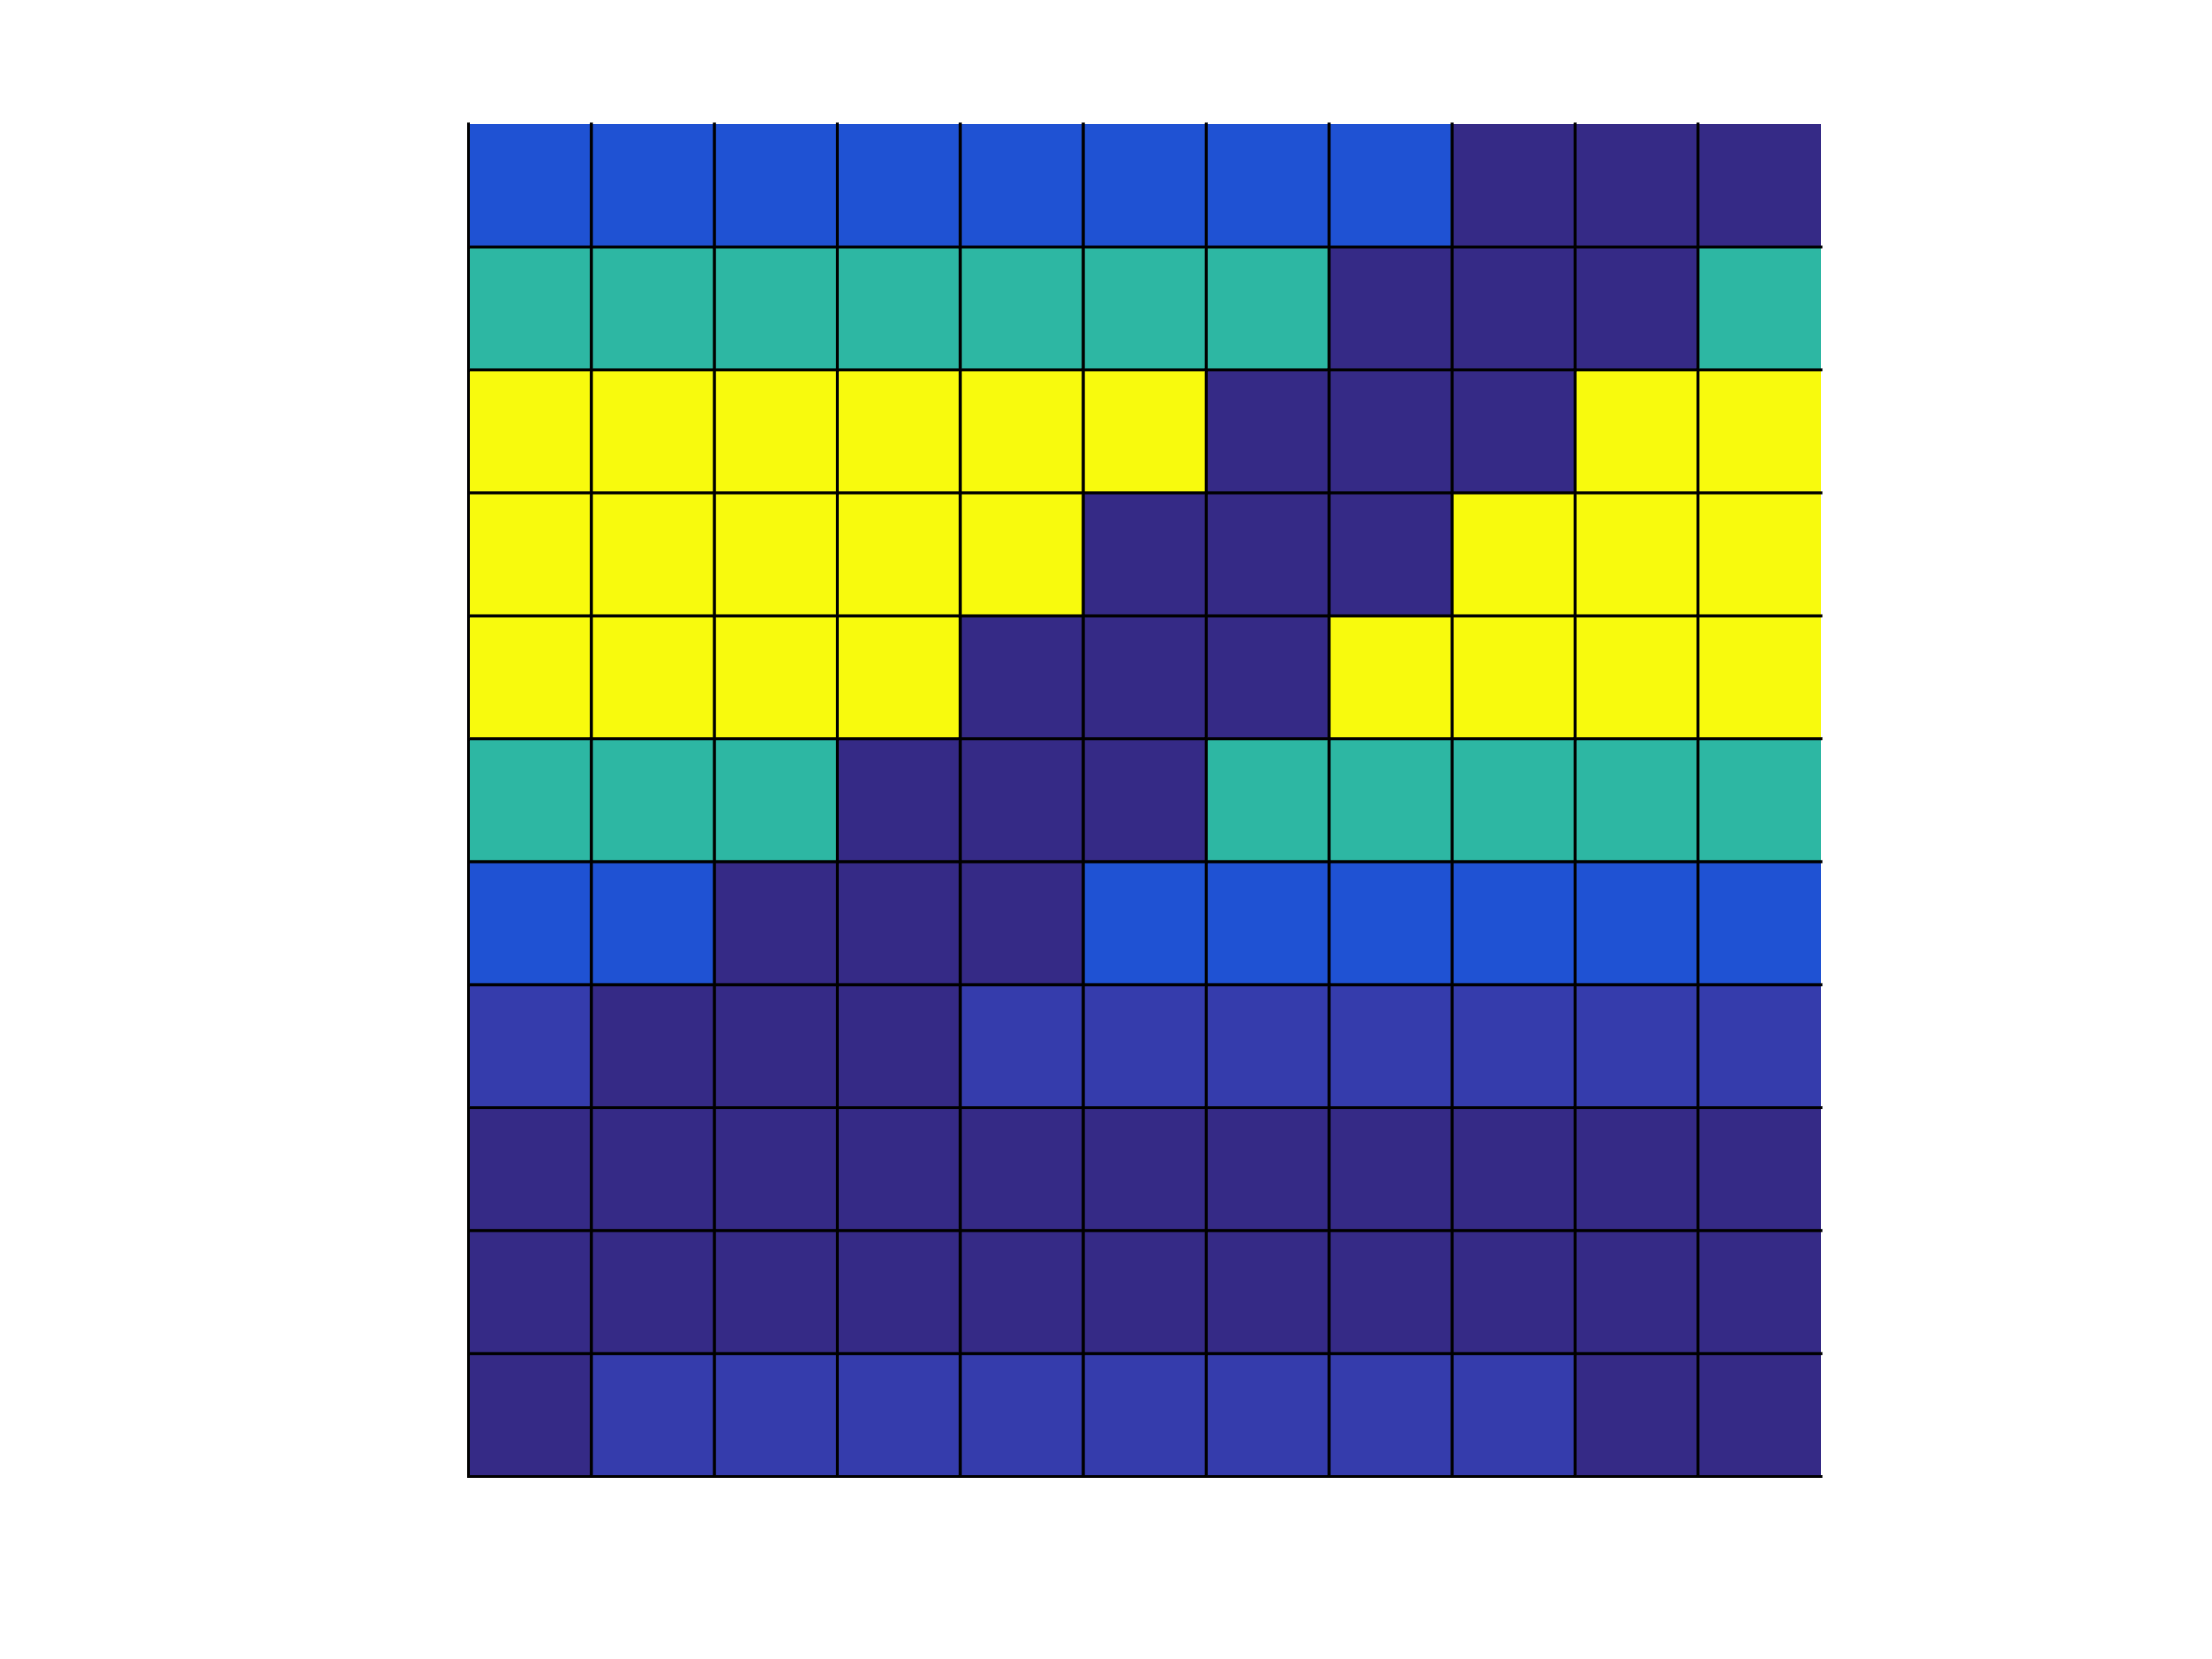
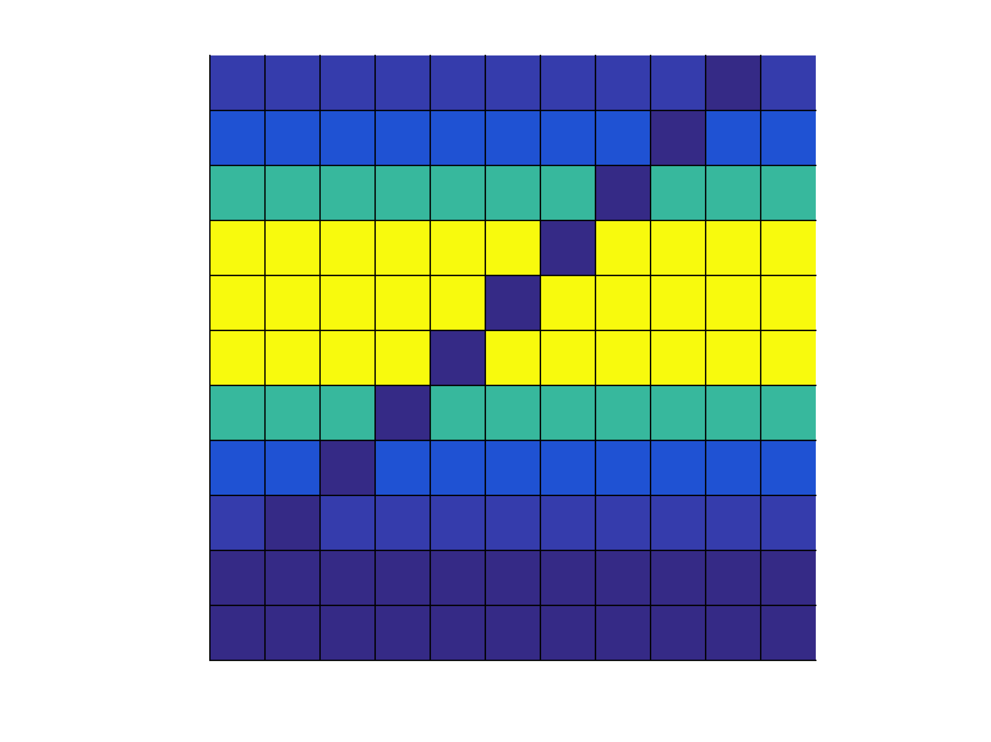
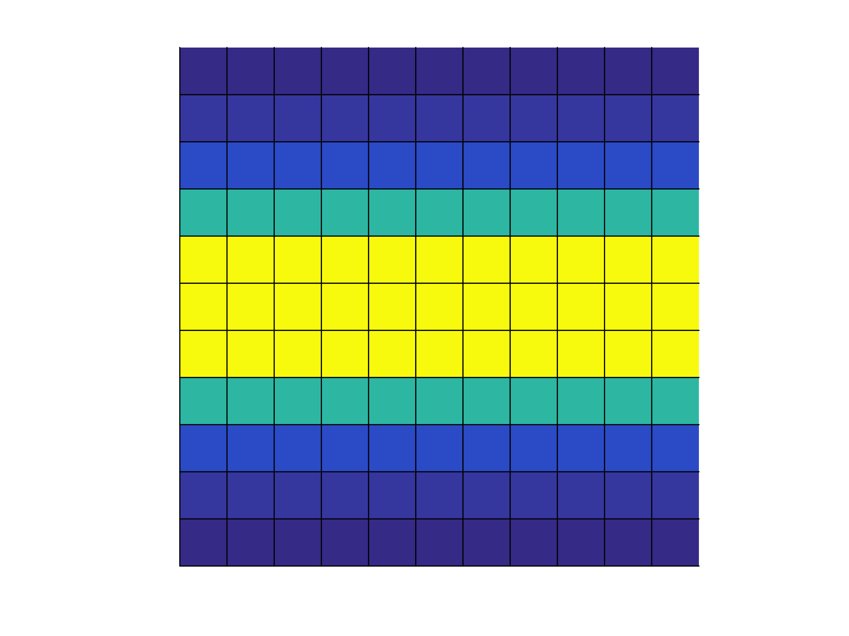
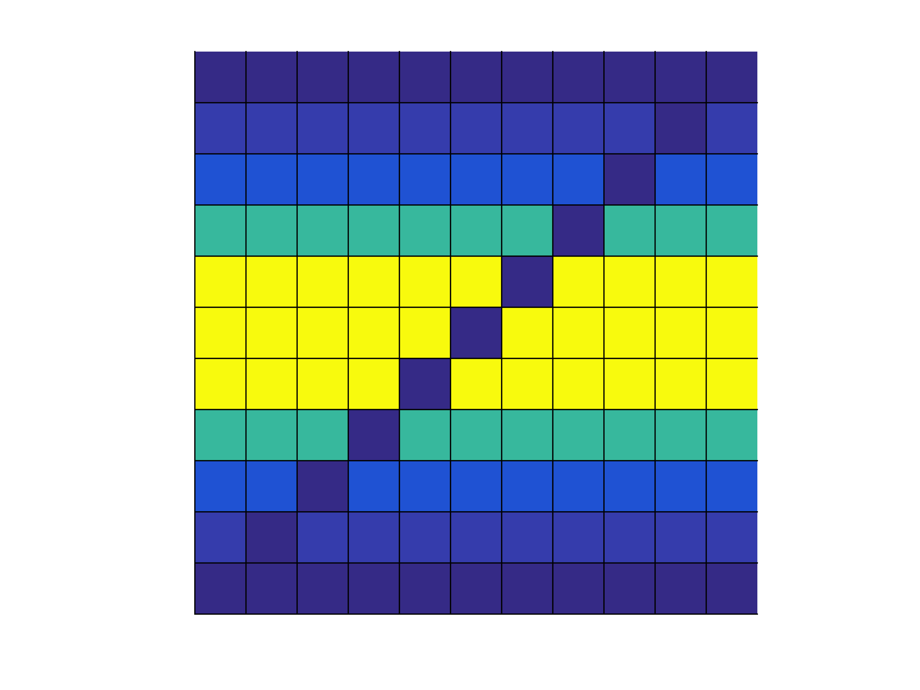
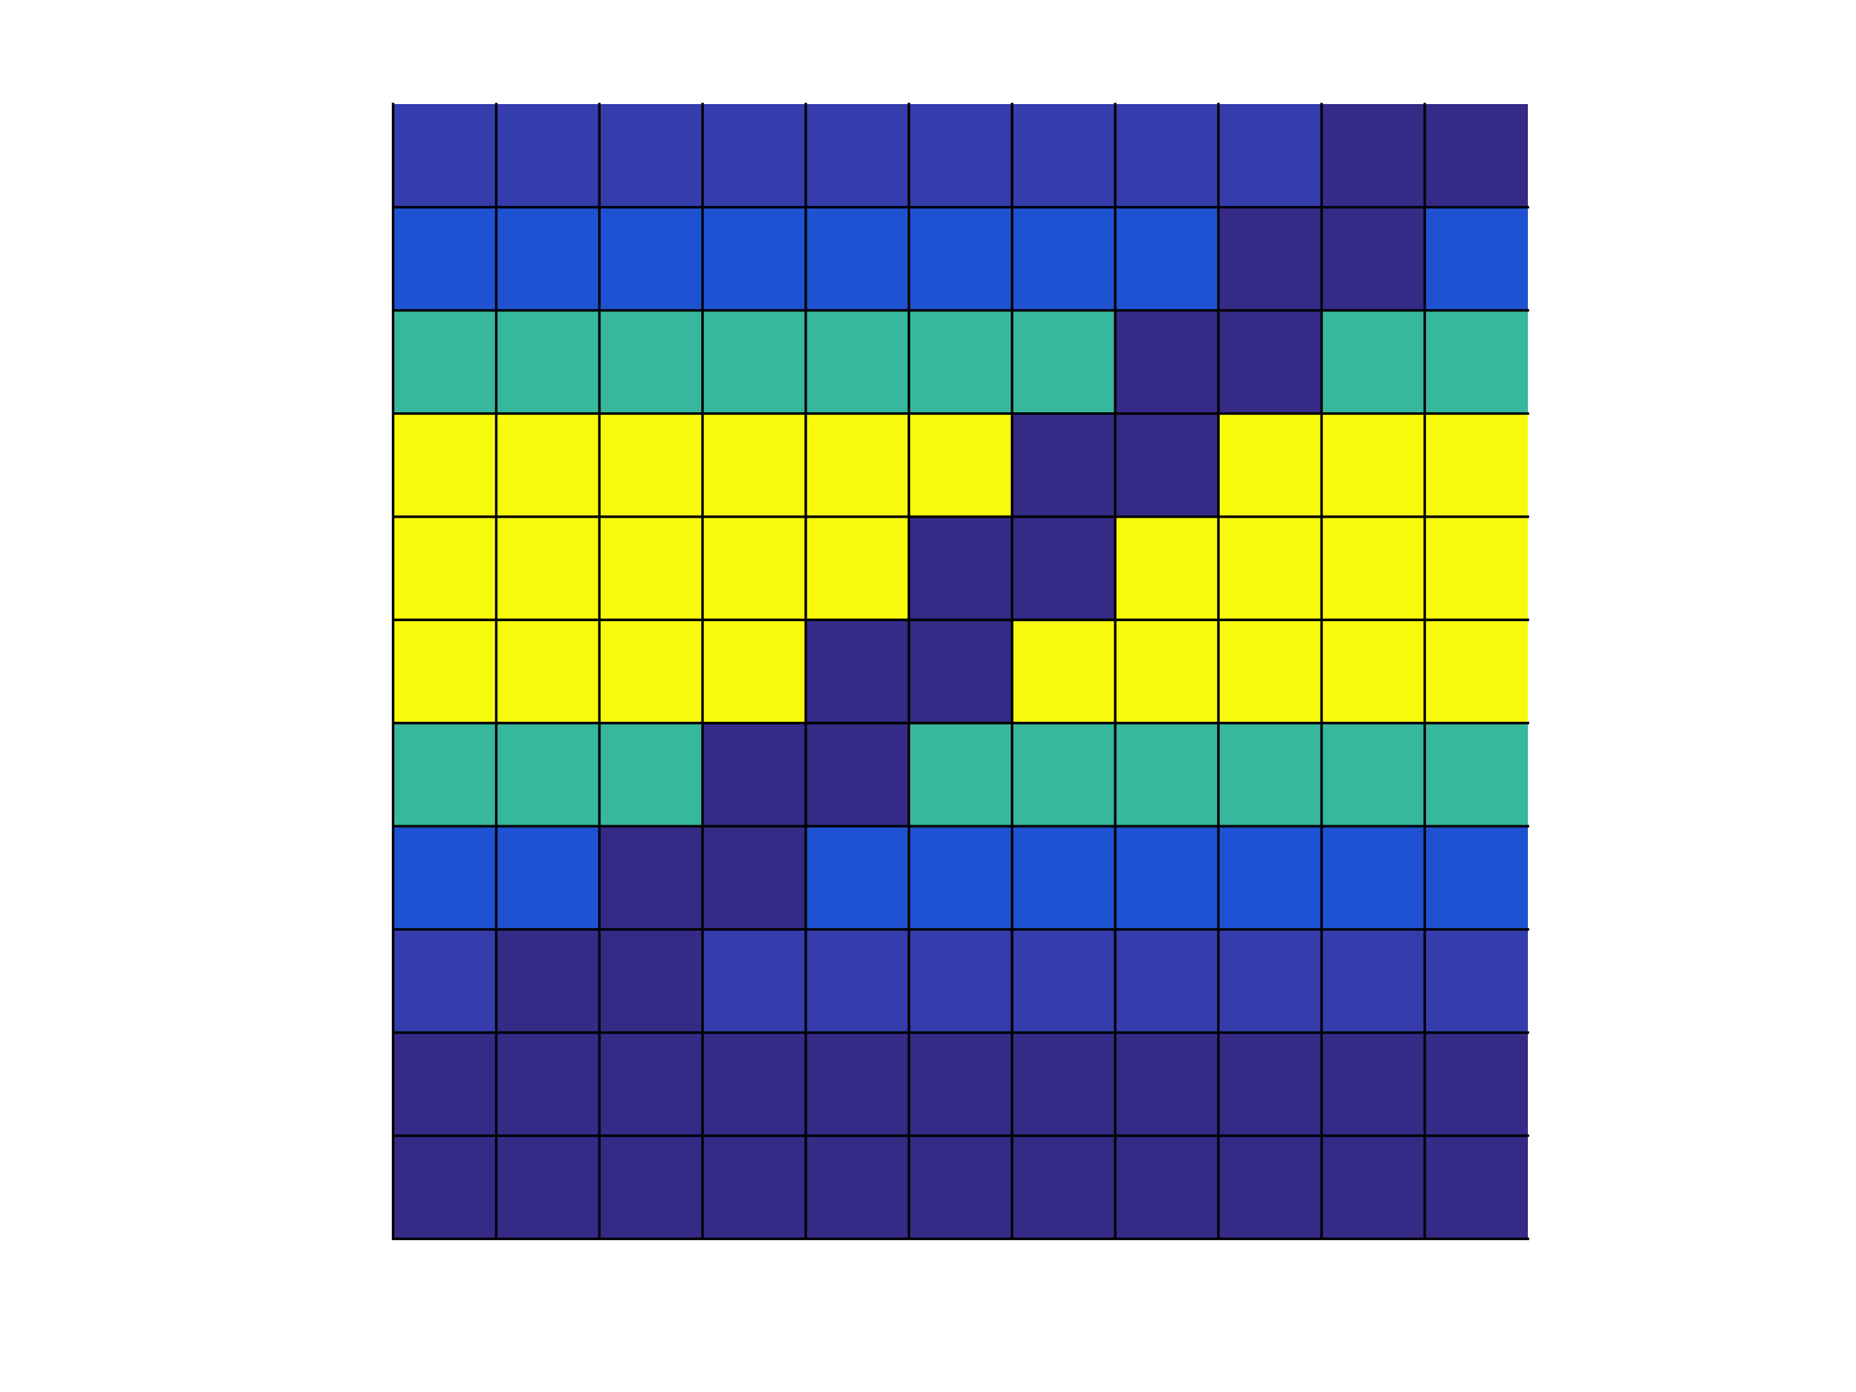
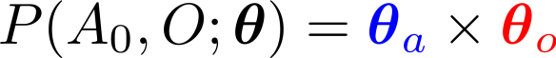
Histogram-SLAM
2
Exponential space & time complexity !
Notes:
Consider the initial beliefs of the agent regarding its own position and that of the object. The marginalise are parameterised by discrete bins which contain valid probabilities.
The initial joint distribution is represented by the product of the marginal, both random variables are initially independent. Both location beliefs can be extracted by marginalising the joint distribution.
We are considering a haptic search setting which implies that the object is sensed only when the agent enters in direct contact with the object. This leads the measurement likelihood to have the following form. Given a positive sensation the likelihood function will be zero everywhere with the exception of states of the diagonal states in the joint distribution, both the agent and object must occupy the same state.
Given no positive detection of the object Y=0 the likelihood is zero in all states in which both the agent and object occupy the same state and one otherwise.
The issue with the direct parameterisation of the joint distribution is that the number of parameters grows exponentially with the number of objects.
We will introduce a filter which instead scales linearly.

Slide 3
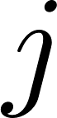
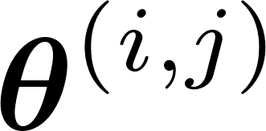
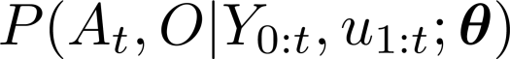
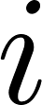
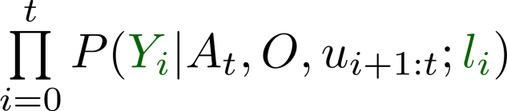
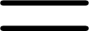
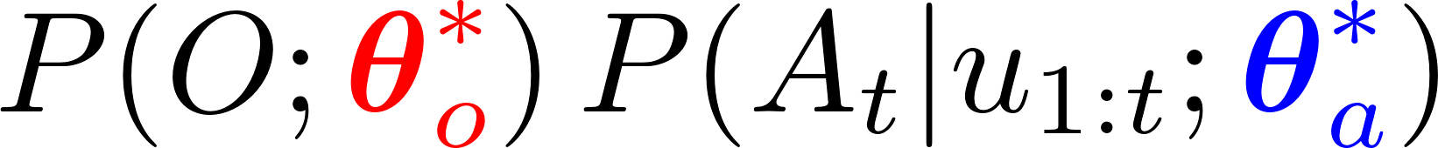
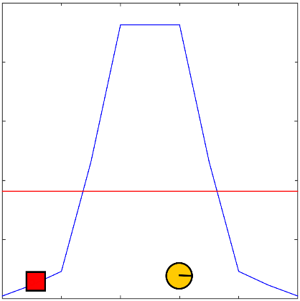
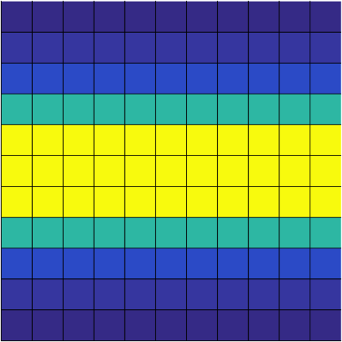
Measurement Likelihood Memory Filter (MLMF)
3
Histogram-SLAM
value parameterisation
MLMF-SLAM
functional parameterisation
Measurement likelihood memory:
Notes:
Histogram-SLAM is what I call a value based parameterisation of the joint distribution as each parameter represents in the joint distribution represented a probability. This leads an exponential space complexity.
Instead we introduce a functional parameterisation of the joint distribution which we can an Measurement Likelihood Memory Filter.
The last term is the product of all the likelihood functions since the first time step until the current time step. Each likelihood function is parameterised by a measurement and an offset.
We next given an intuition of these terms and how this filtered joint distribution is the same as the Histogram’s joint distribution.

Slide 4
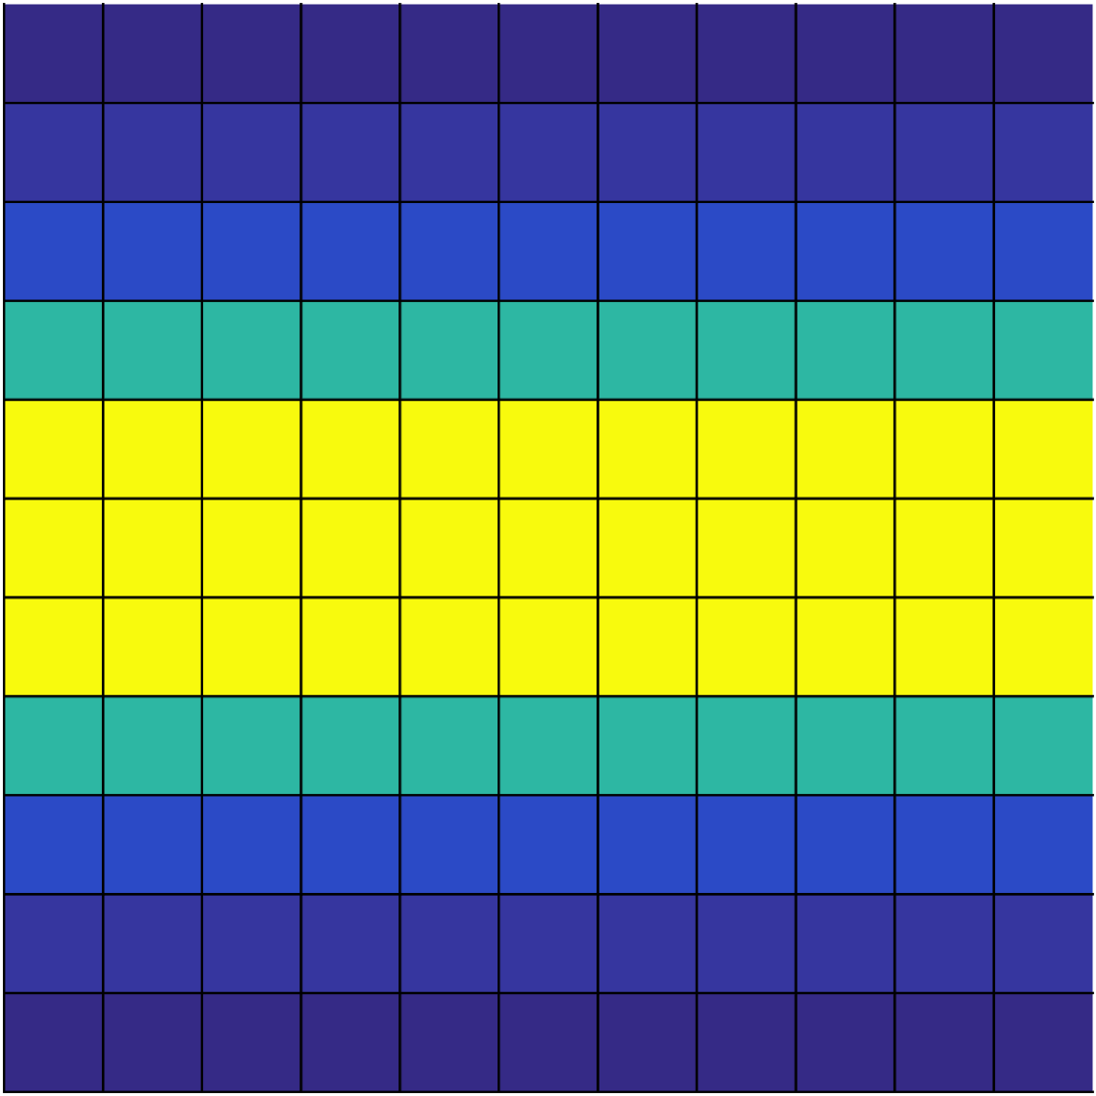
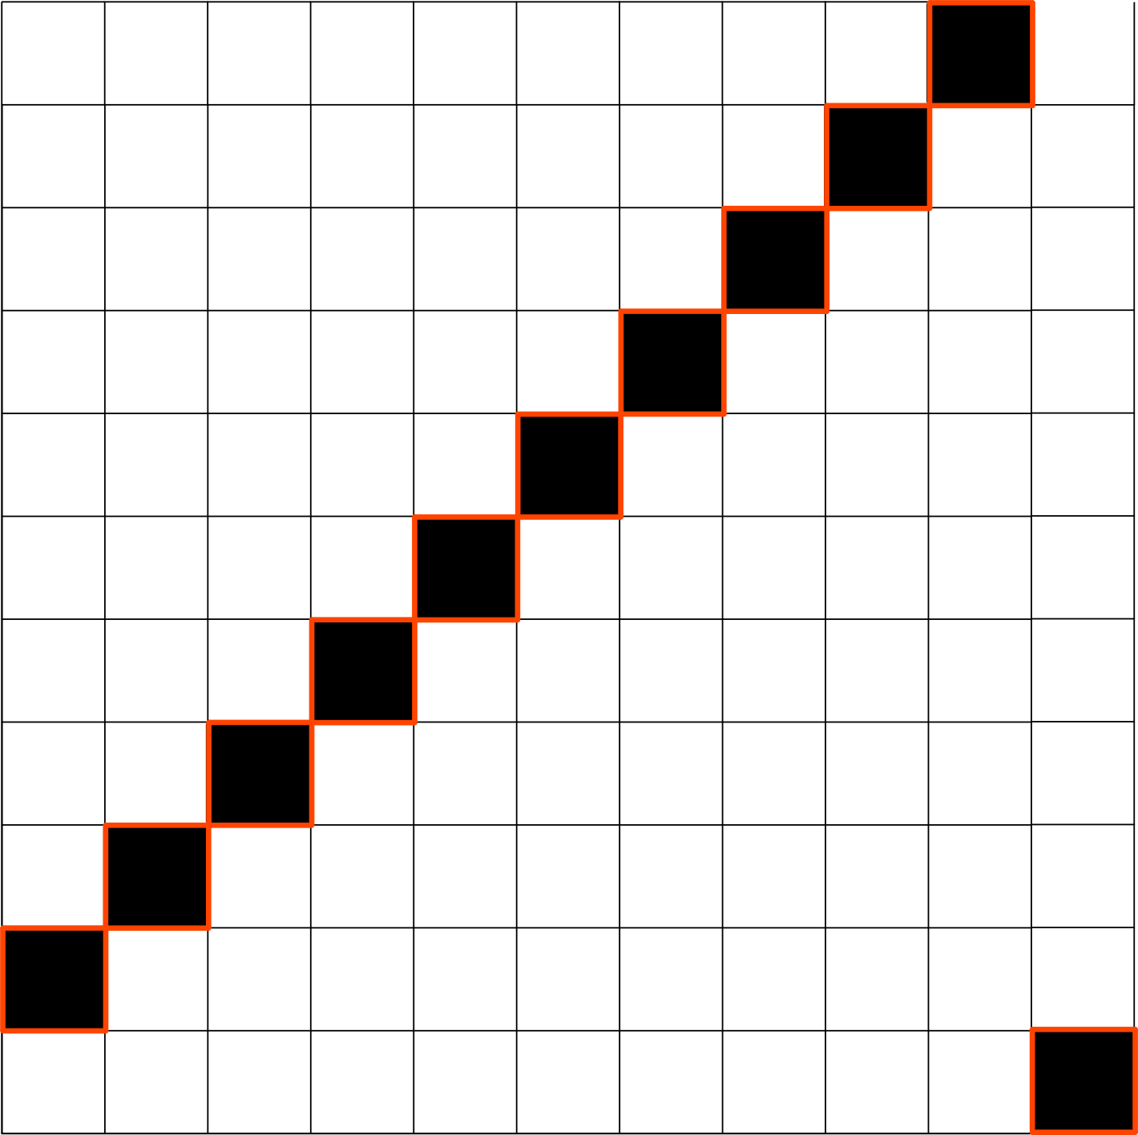
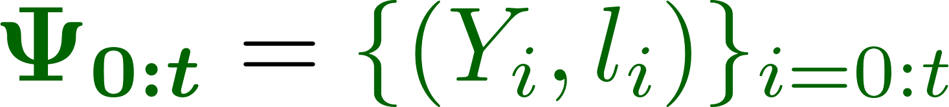


















Measurement Likelihood Memory Filter (MLMF)
3
Histogram-SLAM
value parameterisation
MLMF-SLAM
functional parameterisation
Measurement likelihood memory:
Notes:
Histogram-SLAM is what I call a value based parameterisation of the joint distribution as each parameter represents in the joint distribution r%epresented a probability. This leads an exponential space complexity.
Instead we introduce a functional parameterisation of the joint distribution which we can an Measurement Likelihood Memory Filter.
The last term is the product of all the likelihood functions since the first time step until the current time step. Each likelihood function is parameterised by a measurement and an offset.
We next given an intuition of these terms and how this filtered joint distribution is the same as the Histogram’s joint distribution.

Slide 5








MLMF evidence
5
Histogram
0.02
0.02
0.025
0.025
0.02
0.01
0.015
0.01
0.005
0.002
0
cost
Notes:
The un-normalised joint distribution of our filter is proportional the histogram’s. The difference is given by a normalisation factor which is known as the evidence or marginal likelihood.
This normalisation factor can be computed by fully integrating the joint distribution. This is computationally inefficient.
A more efficient approach can be obtained by taking the derivative of the of the evidence from one time step to the next. To see this we look at the derivative of the evidence given the first measurement.

Slide 6










MLMF evidence
5
0.02
0.02
0.025
0.025
0.02
0.01
0.015
0.01
0.005
0.002
0
cost
cost
sparse likelihood
Notes:
Lets consider the case for the first time step. The derivative of the evidence of the first measurement is given by difference between the joint distribution prior and post multiplication by a measurement likelihood function.
The likelihood function is sparse in the sense that it only changes the values of the joint distribution in a small region, which we call the dependent regions of the joint distribution whilst the independent regions remain unchanged. As a result the re-normalisation constant is equal the sum of the elements in the diagonal of the joint distribution which will become zero.
This is a functional representation of the joint distribution as we do not parametrise each square entry of the would be histogram.

Slide 7














MLMF Marginal
5
5
5
sparse likelihood
Joint parameters
Marginal parameters
5
5
Notes:
We have a full description of the joint distribution but we did not cover how the marginal or location beliefs are obtained.
At the first time step before any measurement is witnessed the marginal beliefs are equal to the parameters of the joint distribution.
Once a measurement is witness, to obtain the updated marignals we have to completely integrate out the joint distribution as was the case for the evidence. This is computationally expensive.
We take a similar approach as we did for the computation of the evidence in that we compute the gradient of the marignals.
Note that we have two set of parameters for the marginal. The first set is is the parameters of the joint distribution whilst the second set are of the beliefs. We compute the joint of the marginal in the joint distribution and apply them to the location beliefs. Again we take advantage of the sparsity of the likelihood function and we know that only the dependent states will be effected. As a result the whole process is computationally inexpensive.

Slide 8









MLMF summary
7
Joint parameters
Marginal parameters
Notes:
(top right)
We summaries the filtering process of the MLMF filter. The joint distribution is parameterised by the original marginal, the history of likelihood functions and the normalisation factor alpha. The filtered marginal or location beliefs are represented by with there own set of parameters.
(top left)
You will see that the dashed lines represent joint distribution’s parameters whilst the sold line represents does of the beliefs, the filtered marginal.
(bottom left)
The joint distribution if it where to be evaluated in every state. The pink line represented where the current likelihood function is applied.
(bottom right)
Plot the memory likelihood term. The green line represents the first likelihood function to be added to the memory term.
We have seen the mechanism of the how the filter works, we next evaluate the space and time complexity.

Slide 9








Space and time complexity
8
Space complexity
Histog
exponential
MLMF
linear
Time complexity (MLMF)
Notes:
We consider the case of two objects, giving us three beliefs when including the agent in a 1 dimensional state space. The resulting joint distribution is 3dimensional.
The histogram filter would require N^3 parameters whilst the MLMF would only require 3 N + N parameters in the worst case scenario. There are 3 random variables and there can be no more than N different measurements and the normalisation constant is a scalar.
The number of parameters of the histogram filter scale exponentially with respect to the number of random variables whilst the MLMF filter scales linearly.
The time complexity will be directly dependent on the number of states which are changed by the likelihood function.

Slide 10







Space and time complexity
8
Space complexity
Histog
exponential
MLMF
linear
Time complexity (MLMF)
likelihood
joint
exponential
Notes:
For the case of one likelihood function when considering a joint distribution with only one object, it effects all states along the diagonal. So for a joint distribution N2 states we have to evaluate the joint distribution in N states. For the case of 3 random variables but only one likelihood function. The likelihood function will from a plane in the joint distribution as it is independent of the second object.
As a result N2 states are now dependent.
We have linear space complexity but an exponential time complexity. To make the MLMF scalable we add an additional assumption of independence.

Slide 11






2D Active-Exploration
9
Agent must find all objects
Maximise Information Gain
States
Histogram
MLMF
Notes:
To evaluate our filter we will be considering an Active-Exploration setting in which the agent must fined both the first and second object represented by the red and green square. We consider a state with 10’000 which if we were to use the Histogram parameterisation we would require N^12 states in contrast our filer will only require N^4 states.
You will notice at an early stage the agent will enter in contact with the red object. Afterwards even if when belief of the agent is not overlapping with that of the object it will nevertheless get updated by any information the agent later acquires.
Full parameterisation in: 1 Terabit of data
MLMF : 10 kilobit
Indepence full param : 200 Mb

Slide 12









Evaluation of Memory likelihood
10
1 Gaussian
4 Gaussians
Uniform
Agent must find the two objects
18 different memory sizes
10 repetitions
little difference after 0.03%
Notes:
One of the more important terms of our filter is the memory term which is the product of all likelihood functions since the first time step to the current. If the state space is very large this terms can become quite large. As a result we evaluate the effect of constraining the number of likelihood functions to be below a percentage value of the number of states N.
We consider the same Active-Exploration setting for case when the agent’s belief is Gaussian whilst the object’s beliefs have this form (laser pointer). Here we plot the number of steps taken until the agent has localised both objects. In this case we can see that there is little difference after a few time steps.

